Slide 1

Seventeen Years
Seventeen years of history as told through the eyes of a teenager.

Slide 2
1991

Slide 3
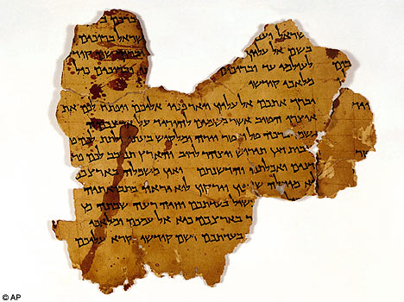
Dead Sea Scrolls put on display at Huntington Library--22nd September

Slide 4
1992

Slide 5

European Union formed with signing of Maastricht Treaty--7th February

Slide 6
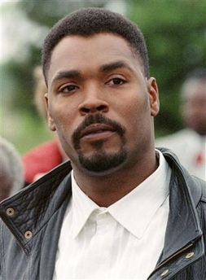
LAPD officers found not guilty in the beating of Rodney King, causing riots throughout the area--26th April

Slide 7
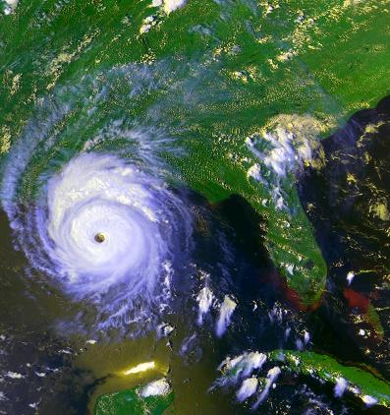
Hurricane Andrew hits South Florida, 23 people are killed--24th-28th August

Slide 8
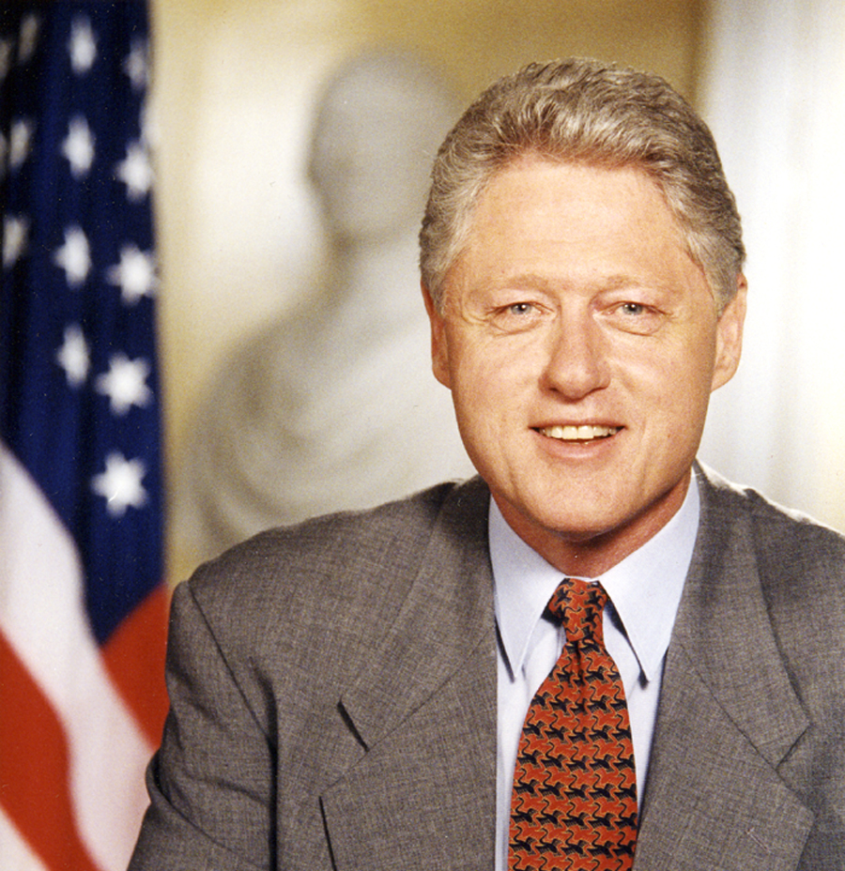
Bill Clinton as president

Slide 9
1993

Slide 10

The Intel Corporation ships the first Pentium chips--22nd March

Slide 11
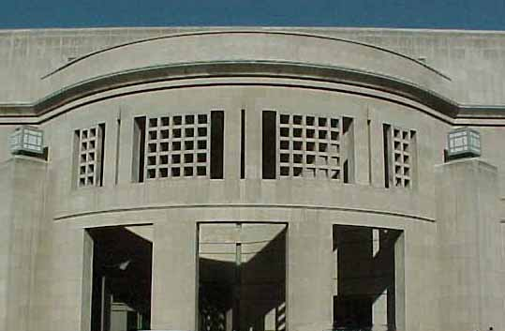
Holocaust Memorial Museum dedicated in Washington D.C.--22nd April

Slide 12
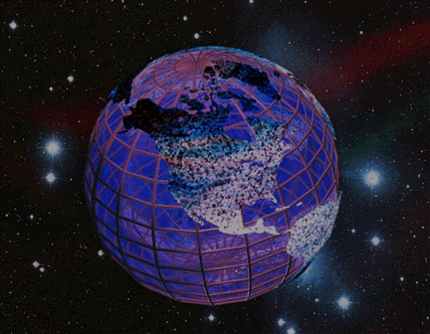
The World Wide Web is born, at CERN, allowing for this project!--30th April

Slide 13

The first version of Microsoft Windows is manufactured-- 27th July

Slide 14
1994

Slide 15
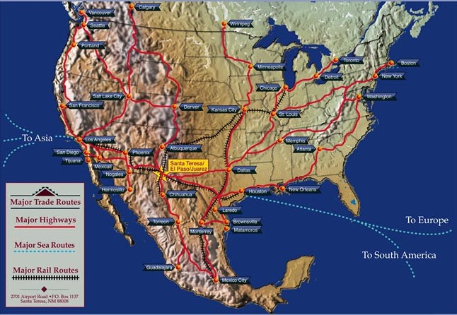
North American Free Trade Agreement goes into effect--1st January

Slide 16
1995

Slide 17
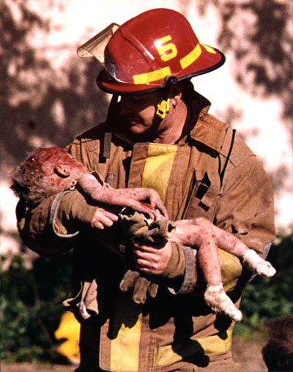
Oklahoma City bombing-168 people are killed, including 19 children--19th April

Slide 18

Online bidding website “eBay” founded--3rd September

Slide 19
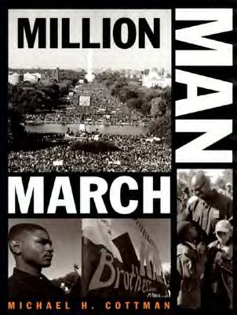
The Million Man March is held in Washington D.C., characterized by black men demonstrating their solidarity and preparedness to take responsibility for their communities-- 16th October

Slide 20
1996

Slide 21

Nintendo 64 is introduced in North America--29th September

Slide 22

Six-year old JonBenet Ramsey is murdered--26th December

Slide 23
1997

Slide 24

Madeleine Albright becomes first female Secretary of State--22nd January

Slide 25

The first Harry Potter book, Harry Potter and the Sorcerer’s Stone, is published--30th June

Slide 26
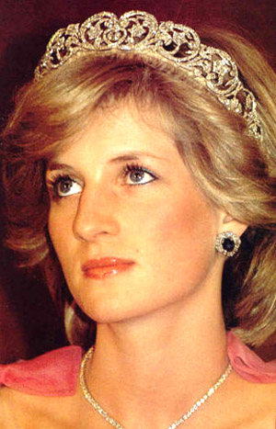
The funeral of Princess Diana is held--6th September

Slide 27
1998

Slide 28

Disney’s Animal Kingdom opens in Walt Disney World-- 22nd April

Slide 29

Google is launched--27th September

Slide 30
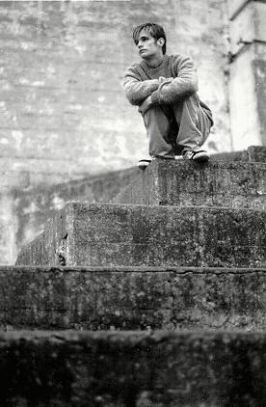
Matthew Shepard dies after being beaten in a gay-bashing incident, heightening national awareness on matters of homophobia--12th October

Slide 31
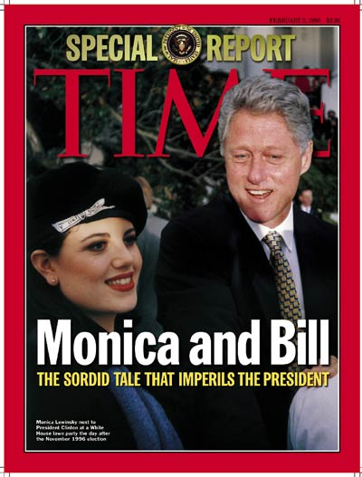
Lewinsky scandal: President Bill Clinton is impeached by the United States House of Representatives--19th December

Slide 32
1999

Slide 33
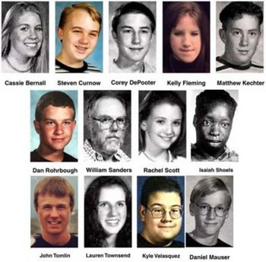
12 students and one teacher killed in Columbine High School massacre--20th April

Slide 34

SpongeBob SquarePants debuts on Nikelodeon--1st May

Slide 35

Lance Armstrong wins his first Tour de France--25th July

Slide 36
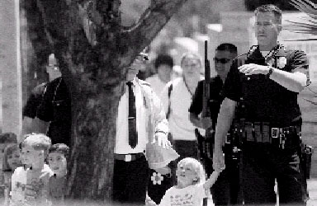
White supremacist attacks a daycare in the Los Angeles Jewish Community Centre Shooting--10th August

Slide 37
2000

Slide 38

Y2K passes without serious incident--1st January

Slide 39
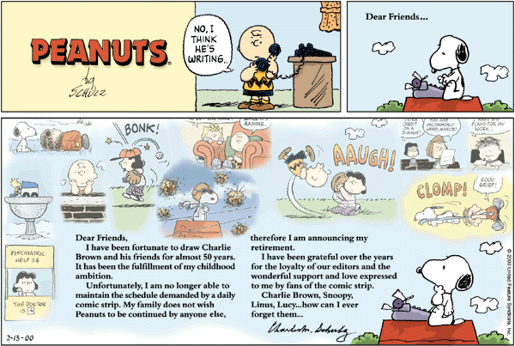
The final Peanuts comic strip is published--13th February

Slide 40
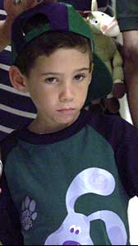
Elian Gonzalez is taken from Miami, Florida, to Washington D.C. where his father awaits him, ending one of the most publicized custody battles in U.S. history--22nd April

Slide 41
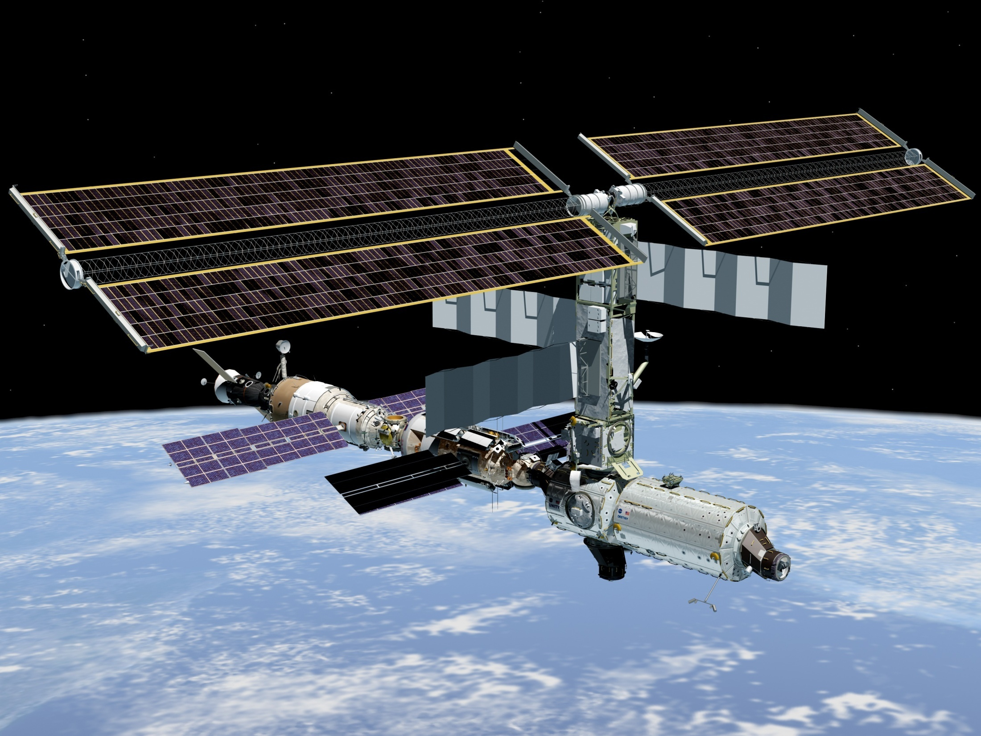
First resident crew enters International Space Station-- 2nd November

Slide 42
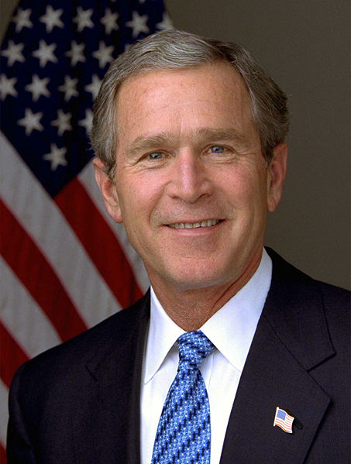
George W. Bush becomes president of the United States after Supreme Court stops Florida’s vote recount--13th December

Slide 43
2001

Slide 44


Wikipedia, the free online encyclopedia, goes online-- 15th January

Slide 45


Two new television shows, Invader Zim and Fairly Odd Parents, premier on Nickelodeon--30th March

Slide 46
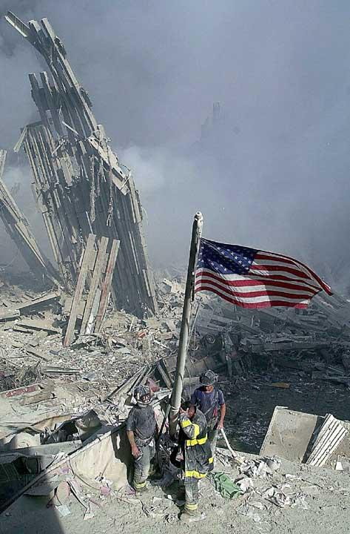
The September 11th terrorist attacks take the lives of almost 3,000 people in New York, Virginia, and Pennsylvania--11th September

Slide 47
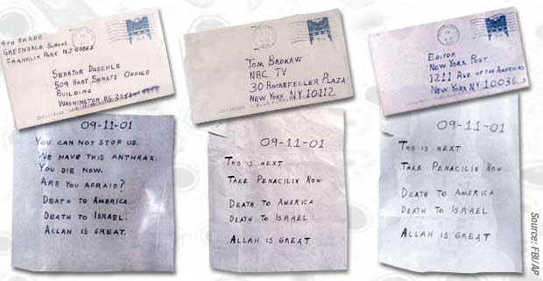
The 2001 Anthrax Attacks begin--18th September

Slide 48
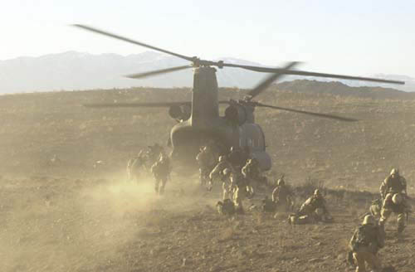

The United States, with participation from the UK, invades Afghanistan--7th October
The Patriot Act becomes a law, with much criticism--26th October

Slide 49



The iPod is released--23rd October
The Xbox and the Gamecube are released in North America within three days of each other--15th and 18th November

Slide 50
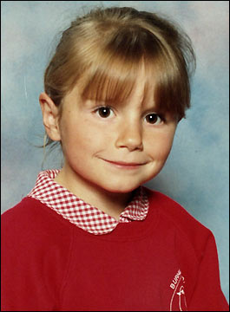
Roy Whiting is convicted of murdering Sarah Payne. The case sparked the campaign for releasing pedophiles’ locations to parents--12th December

Slide 51
2002

Slide 52
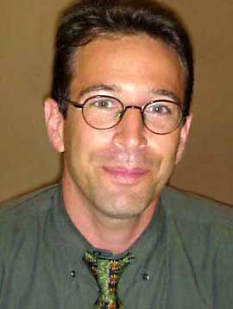
Reporter Daniel Pearl is kidnapped in Pakistan--23rd January, and killed--21st February

Slide 53
2003

Slide 54
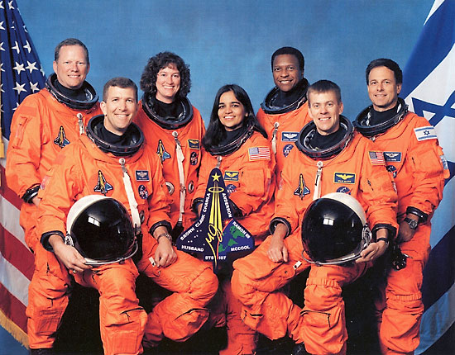
The space shuttle Columbia disintegrates upon re-entry, killing all seven astronauts aboard--1st February

Slide 55

A global alert is issued on SARS--12th March

Slide 56
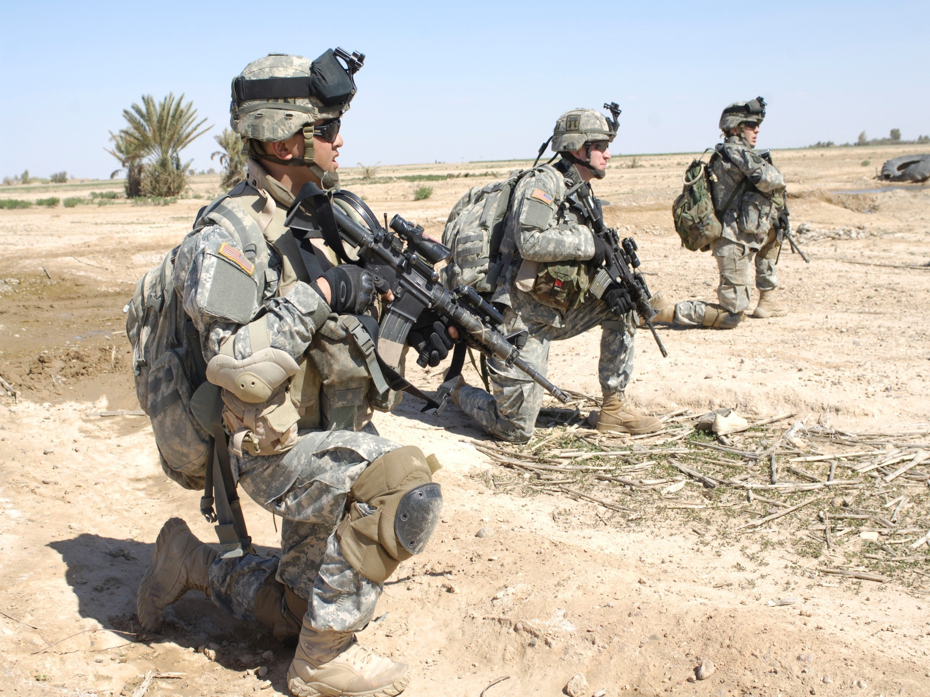
Troops from the United States invade Iraq--20th March

Slide 57

The Human Genome Project is finished, effectively mapping 99% of the human genome to 99.99% accuracy--14th April

Slide 58
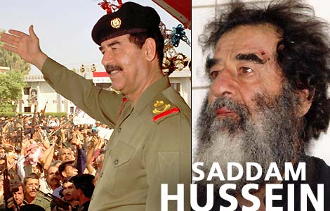
Saddam Hussein is apprehended by the U.S. army--
13th December

Slide 59
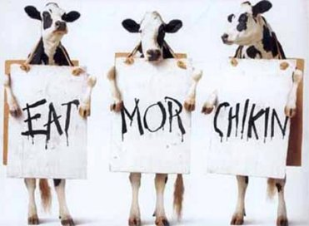
A Mad Cow Disease outbreak occurs in Washington State, reducing beef exports from the U.S.--24th December

Slide 60
2004

Slide 61
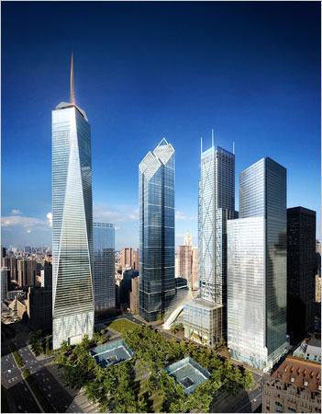
Groundbreaking for the Freedom Tower at Ground Zero in New York City begins--4th July

Slide 62
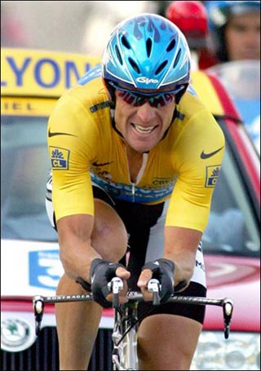
Lance Armstrong wins his sixth consecutive Tour de France cycling title--25th July

Slide 63
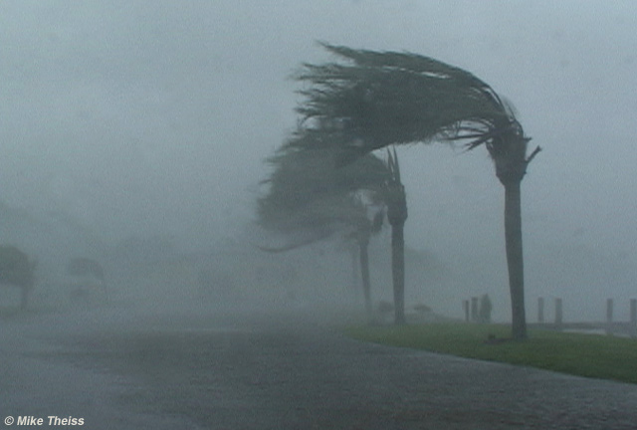
Hurricane Charlie hits Florida, killing 27 people--13th August

Slide 64
George W. Bush defeats John Kerry in the 2004 presidential election--2nd November

Slide 65
2005

Slide 66

North Korea announces its possession of nuclear weapons as a precautionary step to protect itself from the United States-- 10th February

Slide 67
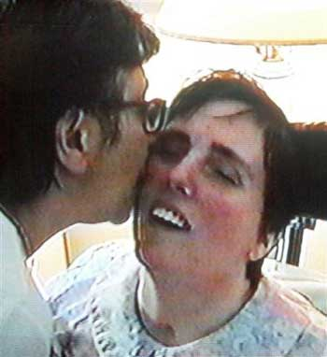
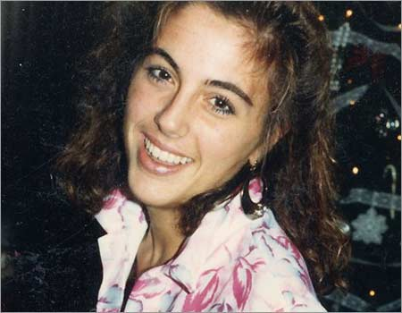
Terri Schiavo dies after her feeding tube is removed--31st March

Slide 68
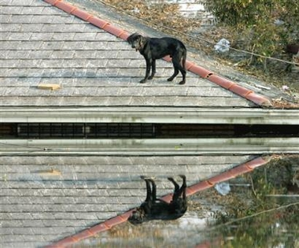
Hurricane Katrina hits the gulf coast, killing over 1,800 people--29th August

Slide 69
2006

Slide 70
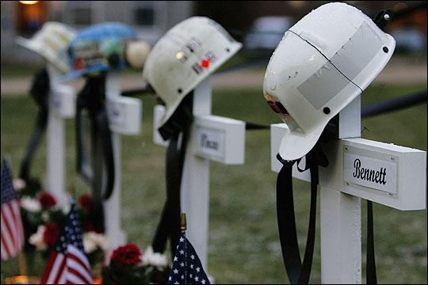
Twelve miners are discovered dead in the Sago Mine Disaster in West Virginia-- 3rd January

Slide 71
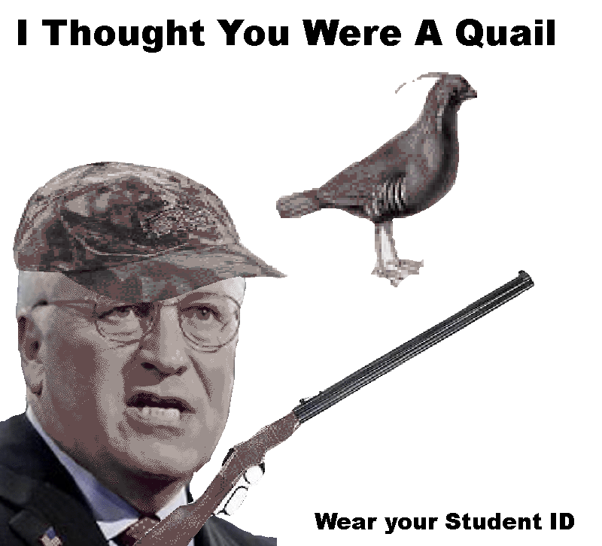
Dick Cheney accidentally shoots lawyer and friend, Harry Whittington, in the face with a shotgun--11th February

Slide 72
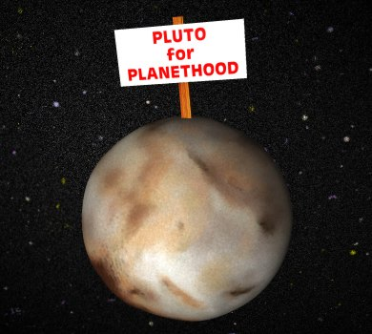
9th planet…until 24th August

Slide 73
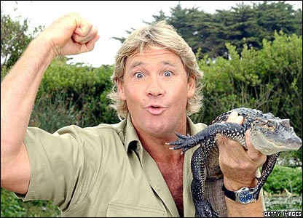
Steve Irwin dies from a sting ray stinger to the heart --4th September

Slide 74

Nintendo releases the Wii--19th November

Slide 75
2007

Slide 76
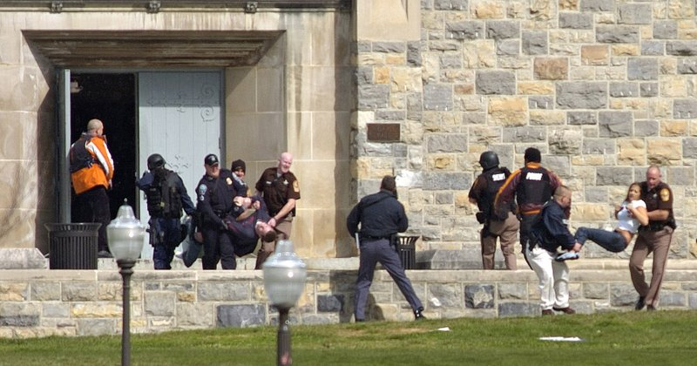
Thirty-two people are killed during the Virginia Tech Massacre--16th April

Slide 77
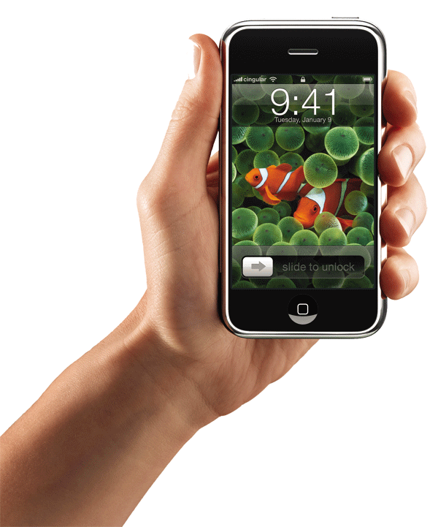
The Apple iPhone is introduced in the U.S.--29th June

Slide 78


The final installment of the Harry Potter series, Harry Potter and the Deathly Hallows is published--21st July

Slide 79

The Writer’s Guild of America goes on strike--5th November, 2007-12th February, 2008

Slide 80
?
?
?
2008
?
?
?
?
?

Slide 81
This slide show created and presented by Sarah Singer for AP U.S. History—Semester II Project.
Hard copy thesis presented for explanatory purposes.
For a list of both picture and research sources, see hard-copy “References” page.

